Slide 1

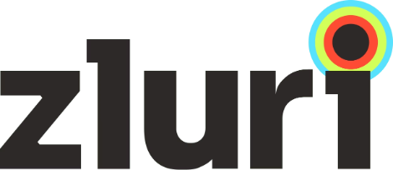
Solving the Modern SaaS Chaos
Today's organizations deploy hundreds of SaaS applications across their operations—but most remain unmanaged and invisible to IT. This sprawl creates a perfect storm of challenges that threaten security, access automation - creating operational bottlenecks.
Zluri help you solve for the “Do right people have the right access to the right resources at the right time?” problem.

Slide 2
The Challenge: Critical Pain Points
Visibility Gap
Licence Under-utilisation
IT teams lack complete visibility into which applications employees are actually using, leading to Shadow IT proliferation and security blind spots.
Without centralized licence tracking and usage monitoring organizations have to manually manage for redundant licenses and under - utilised licences.
Security Risks
Manual Inefficiency
Access sprawl and ungoverned applications create compliance violations and expose sensitive data to unauthorized users.
Manual onboarding and offboarding processes waste hours, create audit gaps, and delay productivity for new hires.

Slide 3

A Unified Platform to Manage Your SaaS Universe
Complete Discovery & Management
One centralized system to discover, manage, and secure every application and user identity across your organization.
Intelligent Automation
Automated workflows handle onboarding, offboarding, and access reviews without manual intervention or tickets.
Real-Time Intelligence
Live insights into usage patterns, spend allocation, and access permissions enable proactive decision-making.
Continuous Licence and Usage Monitoring
Continuous monitoring identifies licence under utilisation opportunities and security risks before they impact your organization.

Slide 4
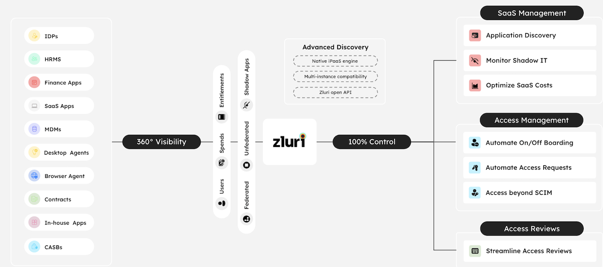
Deep Integrations Across Your IT Landscape
Zluri integrates seamlessly with your existing technology stack—SSO providers, HRMS platforms, finance systems and collaboration tools. Bi-directional data synchronization ensures accuracy and creates a single source of truth for users, applications, and access permissions.
Zluri has around 300 Native Connections - https://www.zluri.com/catalog

Slide 5

Three Modules.
One Platform.
Complete Control.

Slide 6
Zluri's Integrated Module Suite
1
2
SaaS Discovery
Access Management
Comprehensive visibility into your entire SaaS ecosystem. Discover Shadow IT, control spend, and optimize license allocation across departments.
Automate the complete employee lifecycle—from joiner provisioning through role changes to offboarding—with zero manual intervention.
3
4
User Access Reviews
Access Requests
Maintain continuous compliance with automated access certifications and least-privilege governance frameworks.
Empower employees with self-service access requests through policy-based automation, reducing IT bottlenecks and approval delays.

Slide 7
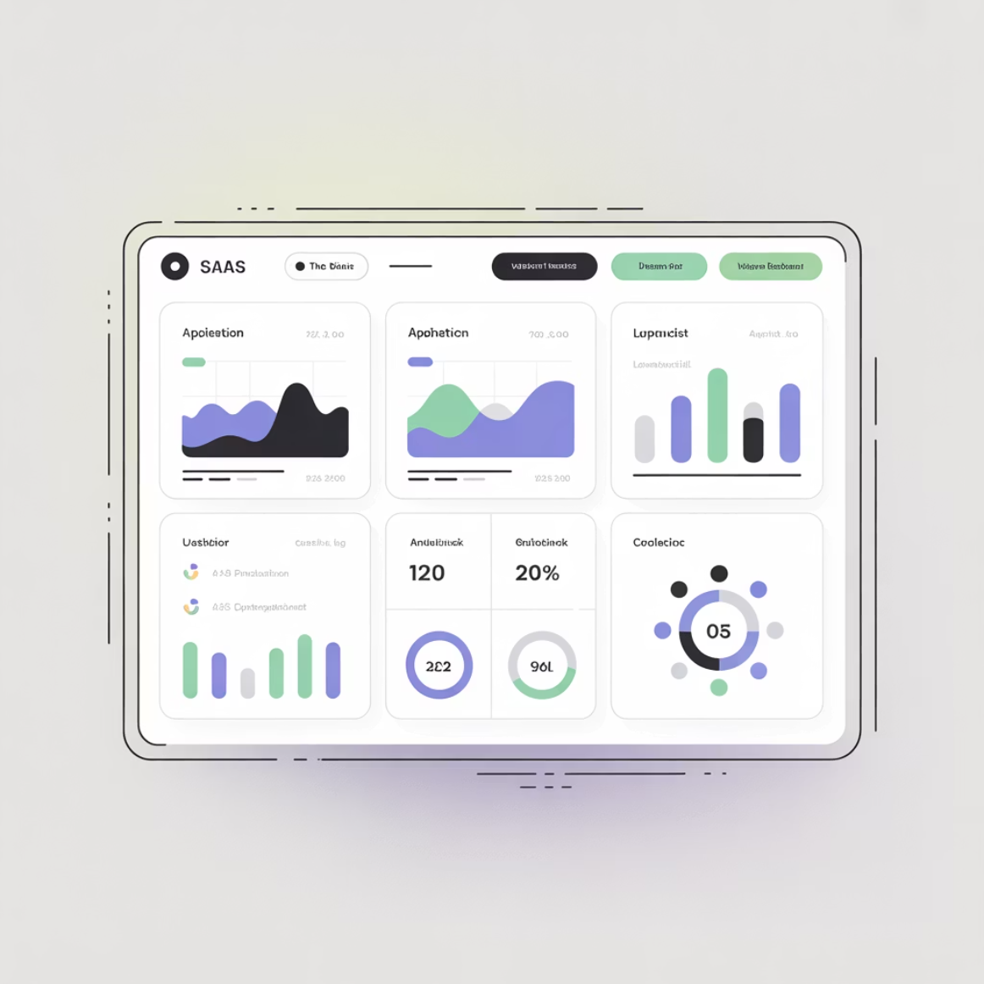
SaaS Discovery : Discover, Monitor, Analyze
Complete SaaS Visibility
Automatically discover all SaaS applications in use, including Shadow IT purchases made outside approved channels
Track usage metrics, cost allocation, and ownership across every department and team
Identify redundant subscriptions and underutilized tools draining your budget
Enable data-driven strategic consolidation and decision making
100%
300
SaaS Visibility
Direct App Integrations
Including Shadow IT
Native connections

Slide 8
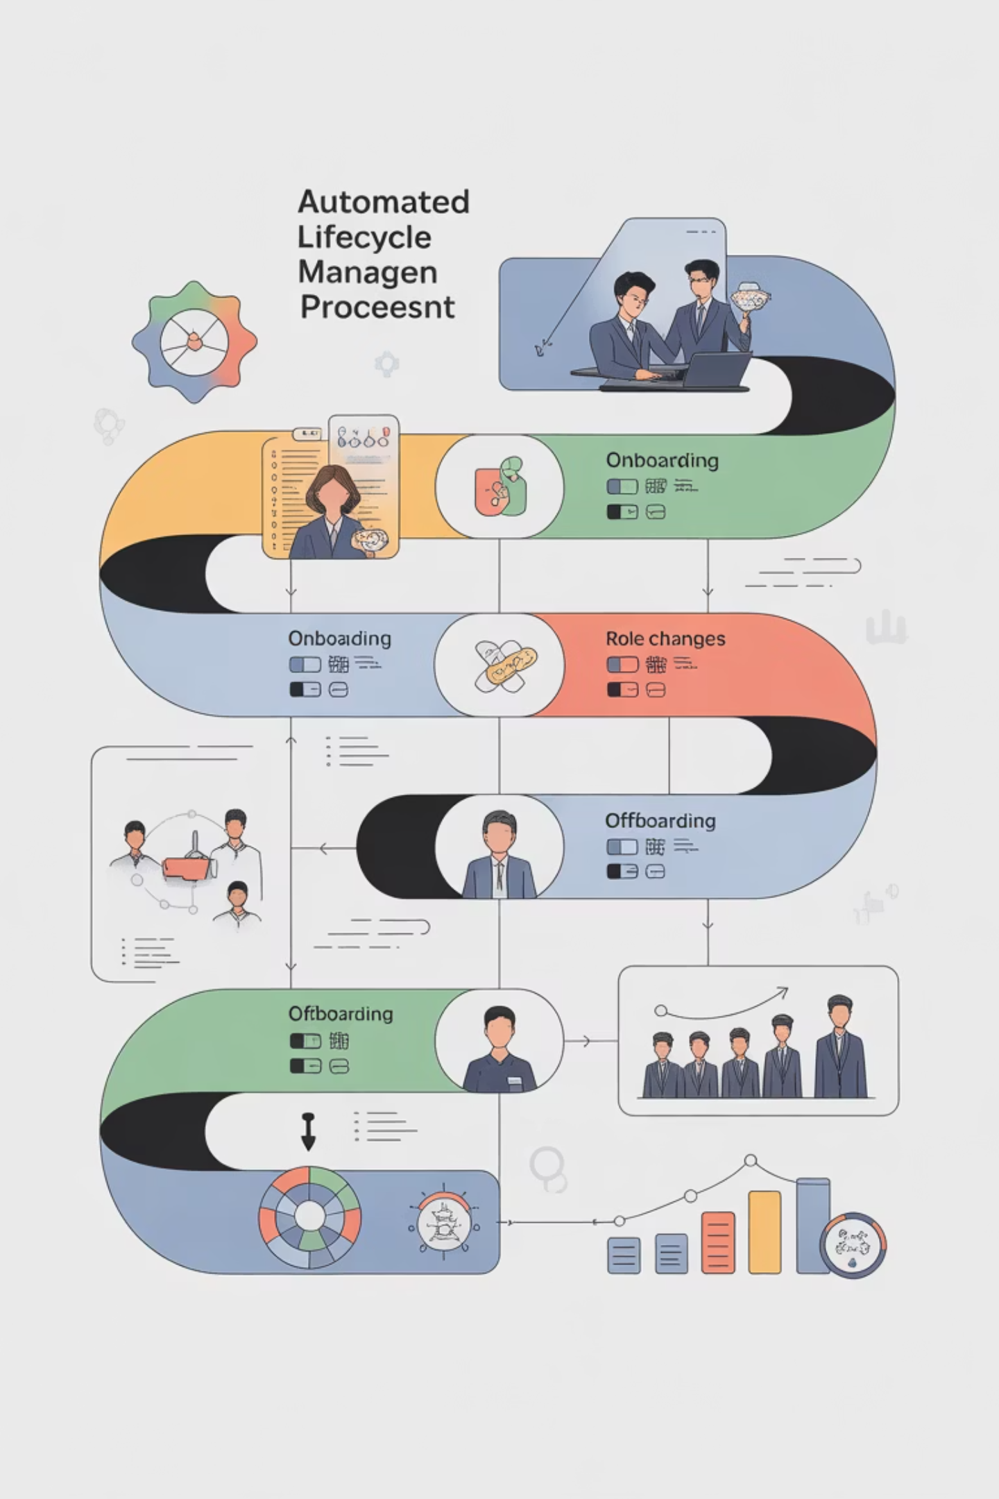



Access Management
Automate Every Employee Journey
Trigger workflows automatically from HR system events—no manual handoffs
Provision or deprovision accounts instantly across all connected applications
Assign appropriate licenses and permissions based on role and department
Maintain comprehensive audit logs for compliance and security reviews
Joiner
Mover
Leaver
Complete deprovisioning
Role-based updates
Instant provisioning

Slide 9
Access Requests
Empower Self-Service Access
Policy-driven access request workflows embedded in Slack
Multi-level approval chains with justification tracking and audit trails
Auto-grant capabilities for pre-approved access patterns
Auto-revoke functionality ensures time-bound access expires automatically

Slide 10
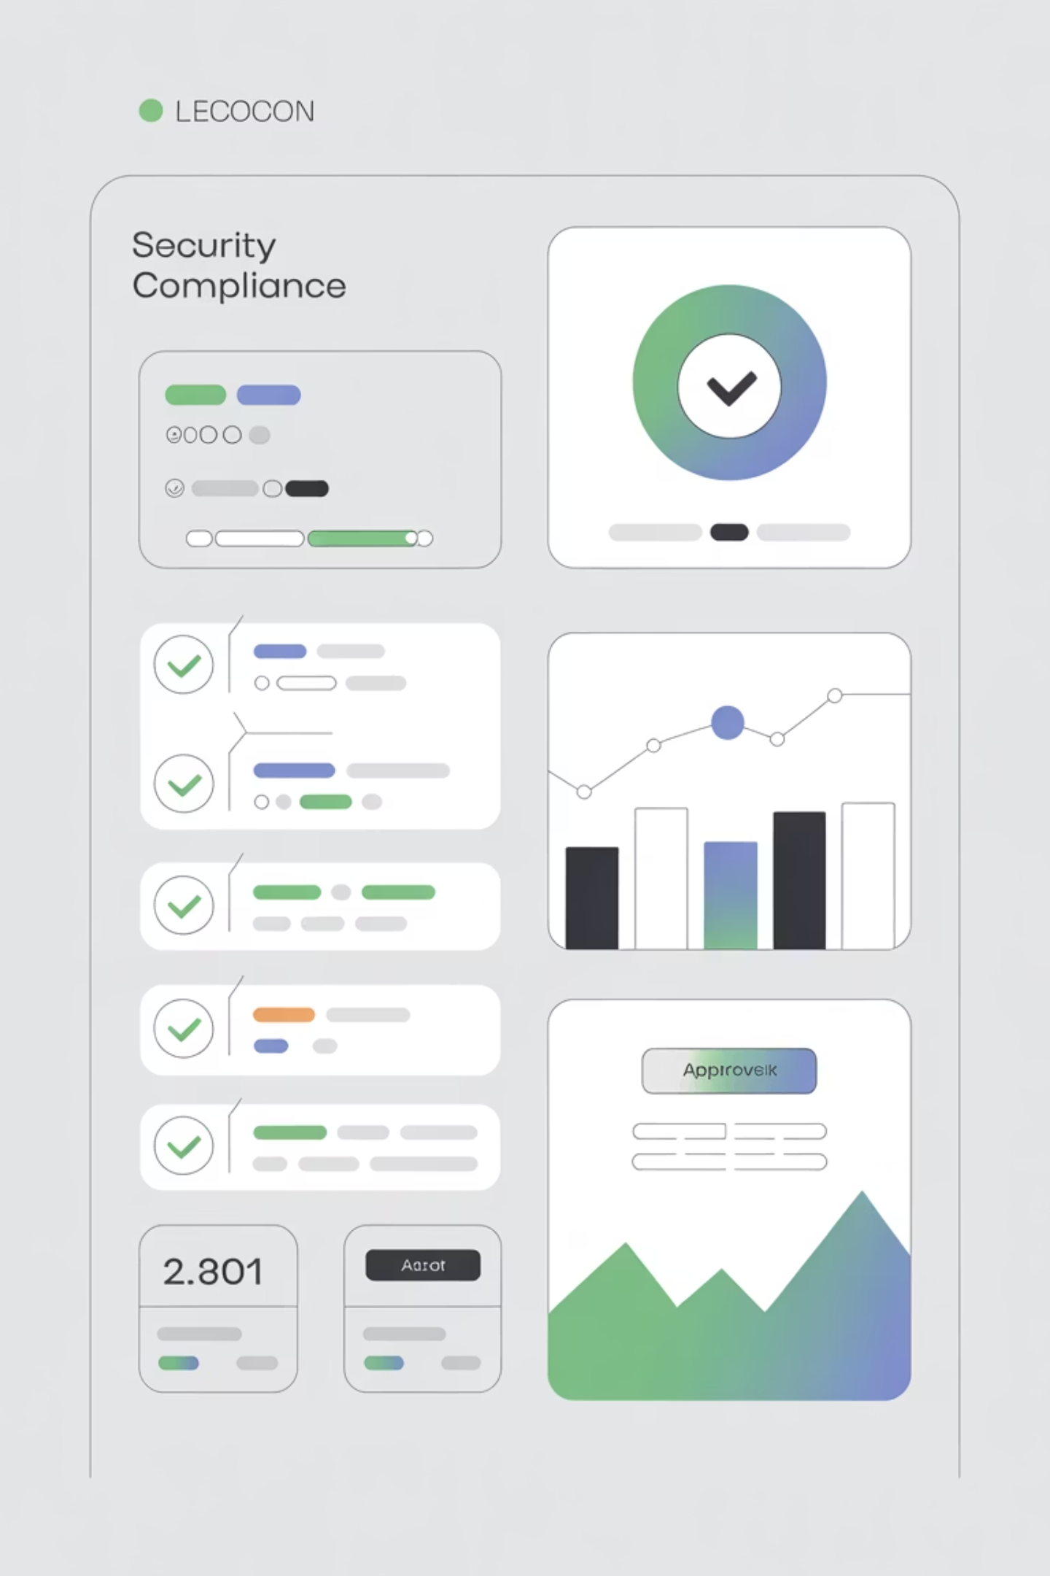
User Access Reviews: Stay Audit-Ready, Always
Automated Certifications
Schedule periodic access reviews automatically based on your compliance calendar and regulatory requirements.
Risk Detection
Identify inactive accounts, over-provisioned users, and privilege creep before auditors or attackers discover them.
Flexible Review Types
Support manager-based, application owner, or role-based review workflows tailored to your organization.
Audit-Ready Reports
Generate exportable compliance reports and trigger auto-remediation for identified access violations.
Continuous Compliance: Zluri maintains least-privilege access governance across your entire SaaS portfolio, ensuring you're always ready for audits without manual preparation.

Slide 11

Re-imagine SaaS and Access Governance
100%
90%
SaaS Visibility
Faster Lifecycle
Complete ecosystem transparency
Onboarding &
offboarding
Ready to Transform Your SaaS Management?
Discover how Zluri can secure your applications, ensure compliance, and manage access —all from one unified platform.
Website: www.zluri.com
Contact: sales@zluri.com

Slide 12

Thank You!
We appreciate your time and interest in Zluri. We're dedicated to helping you secure your applications, ensure compliance, and optimize costs efficiently.
Ready to transform your SaaS management? Visit our website: www.zluri.com

